Slide 1

演算法設計與分析
台大資工系
呂學一

Slide 2
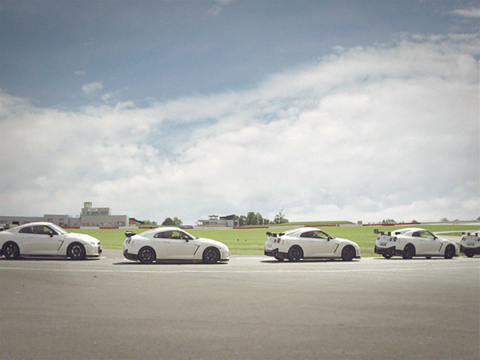
任務
【挑選問題】

Slide 3

任務
【挑選問題】

Slide 4
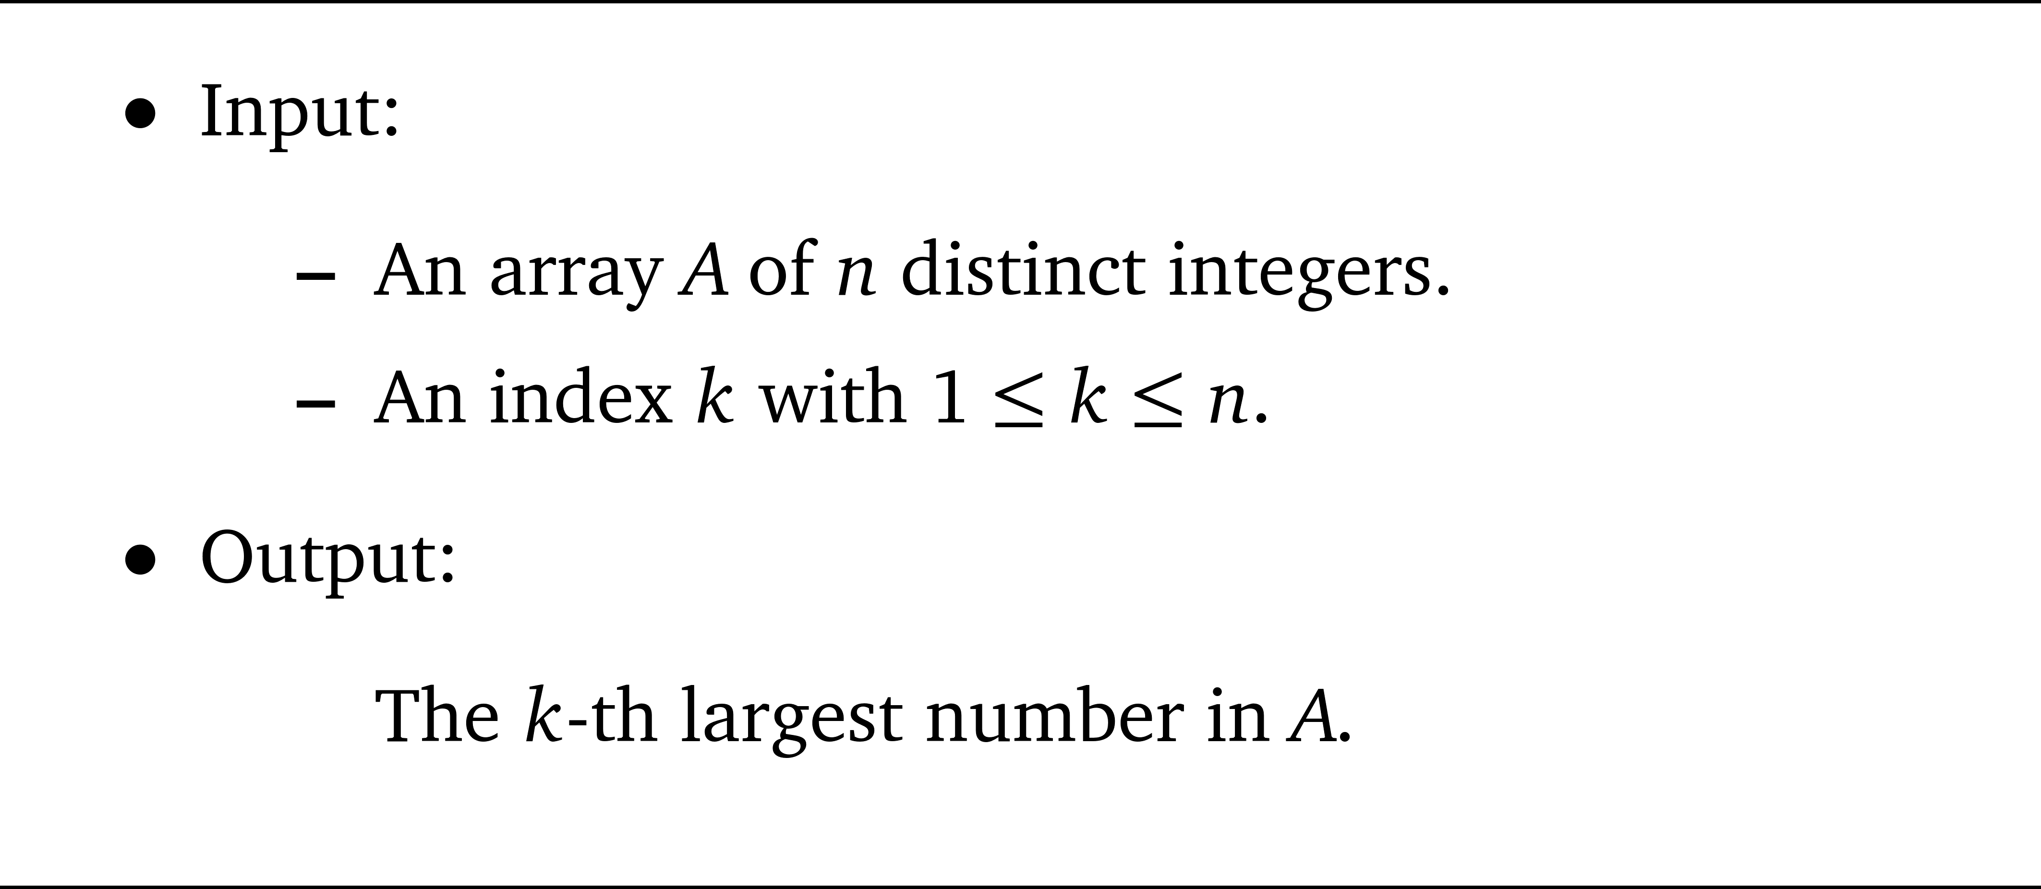
The selection problem

Slide 5

Comparison-based model

Slide 6
n = 10, k = 5
3
7
9
17
5
2
21
18
33
4

Slide 7

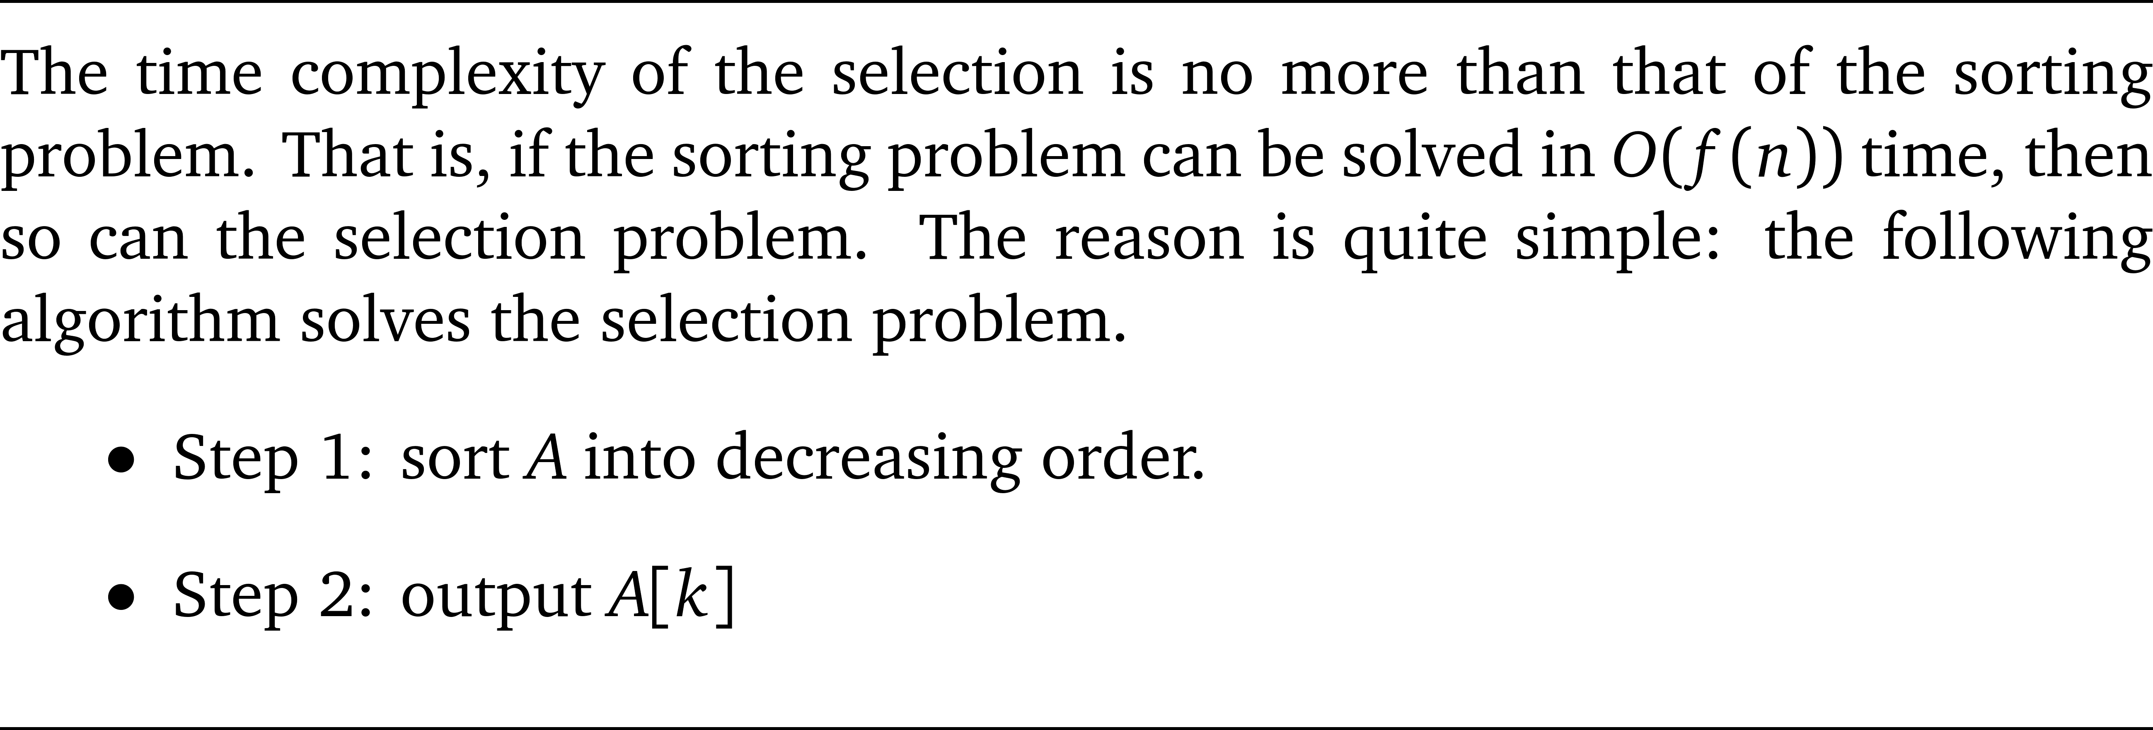
挑選 ≦ 排序

Slide 8

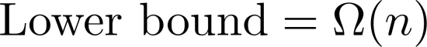
【挑選問題】的複雜度
如果不是
comparison-based
model, upper-bound也許可以直接壓到O(n).

Slide 9

Solvable in O(n) time?

Slide 10

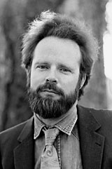



挑選有多難
[STOC’72 & JCSS’73]
A extremely “shining” paper by five authors:
Manuel Blum (Turing Award 1995)
Robert W. Floyd (Turing Award 1978)
Vaughan R. Pratt
Ronald L. Rivest (Turing Award 2002)
Robert E. Tarjan (Turing Award 1986)
The number of comparisons required to solve the problem is between 1.5n and 5.43n.

Slide 11
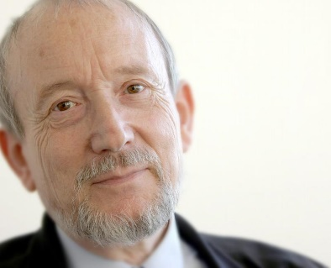
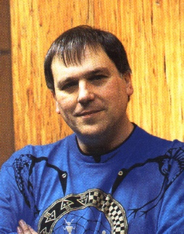



比較次數
Upper bounds:
3n + o(n) by Schonhage, Paterson, and Pippenger (JCSS 1975).
2.95n by Dor and Zwick (SODA 1995, SIAM Journal on Computing 1999).
Lower bounds:
2n+o(n) by Samuel W. Bent and John W. John (STOC 1985)
(2+2⁻⁸⁰)n by Dor and Zwick (FOCS 1996, SIAM Journal on Discrete Math 2001).

Slide 12

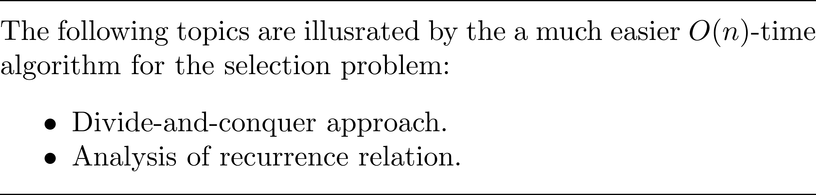
線性時間挑選法

Slide 13
(1) 分群，每群五個傢伙

Slide 14
(2) 每群各自排序 (大→小)

Slide 15
(3) 標竿: 中位數的中位數

Slide 16
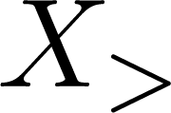
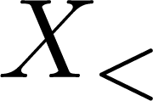
(4) 用標竿分兩堆
MoM
大於MoM的數字
小於MoM的數字

Slide 17
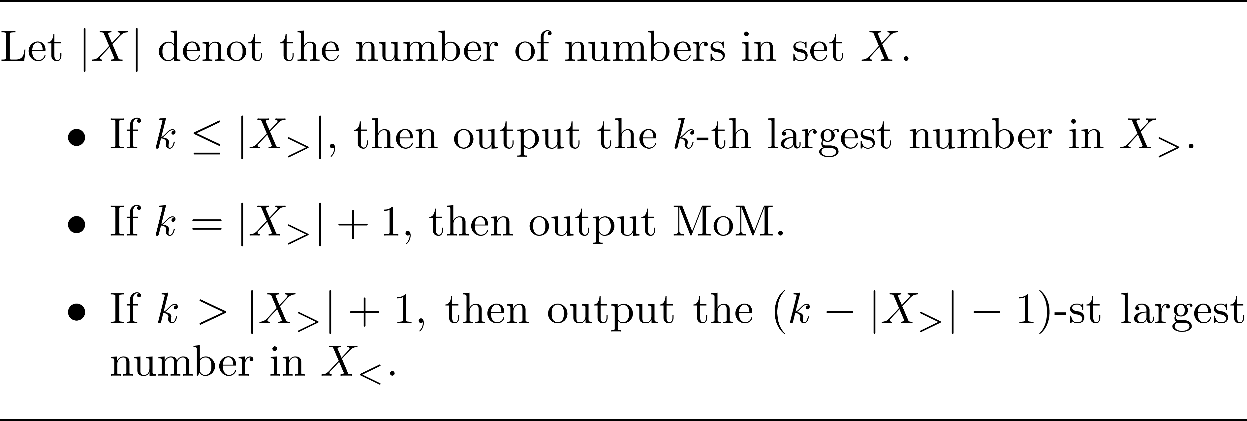
(5) 遞迴

Slide 18
其實有兩個遞迴步驟
Step (2) Determining MoM
從n/5個數字中找第n/10大的傢伙
Step (5) Selection in X< or X>

Slide 19
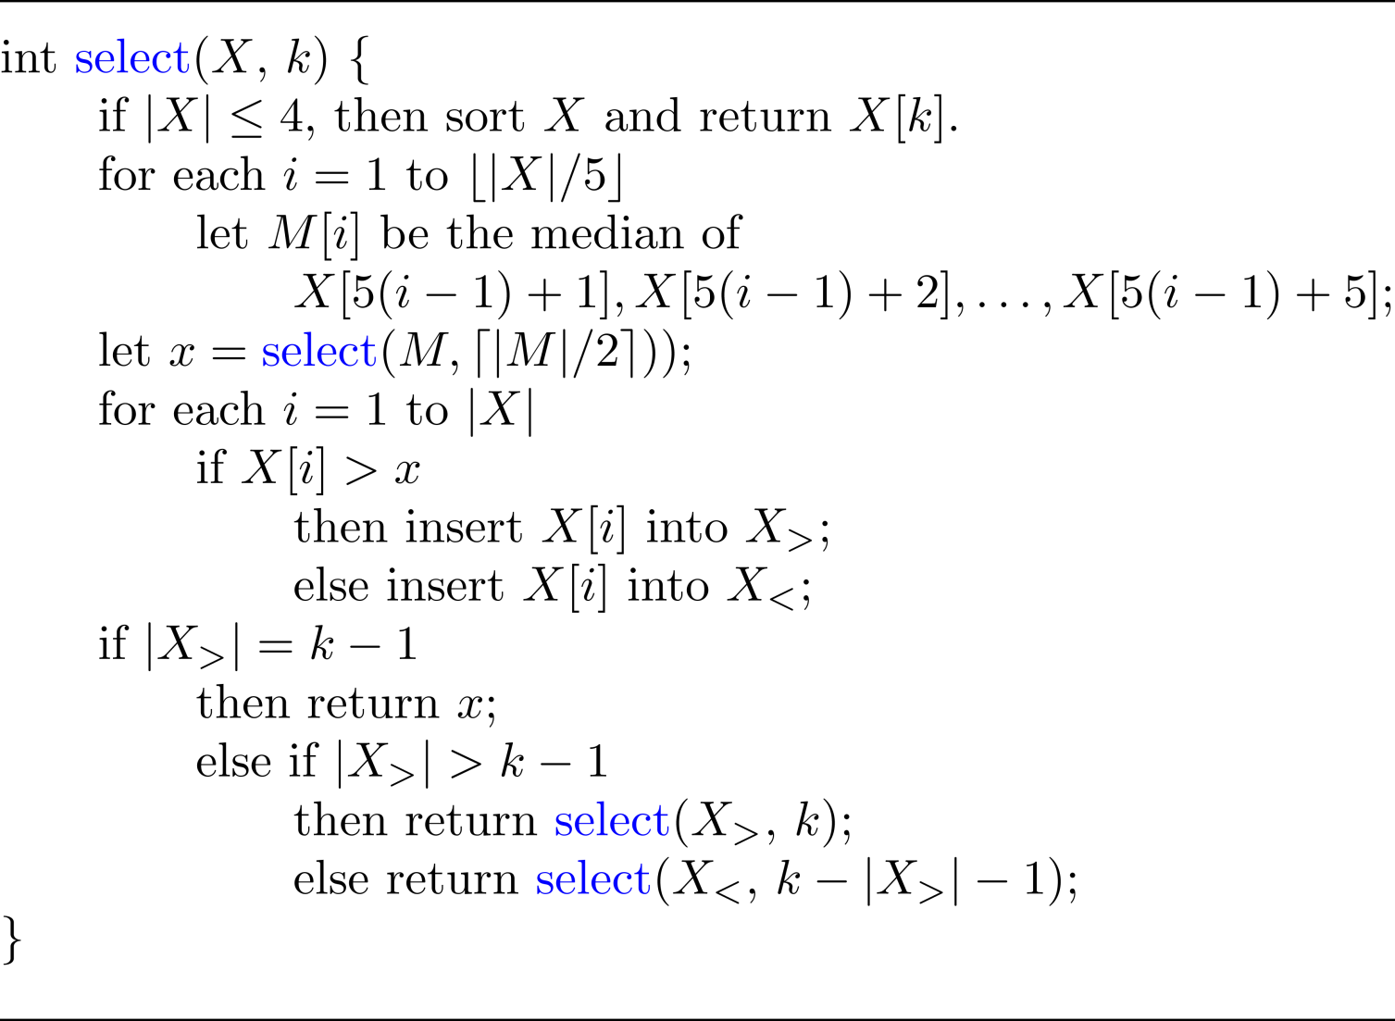
The algorithm

Slide 20
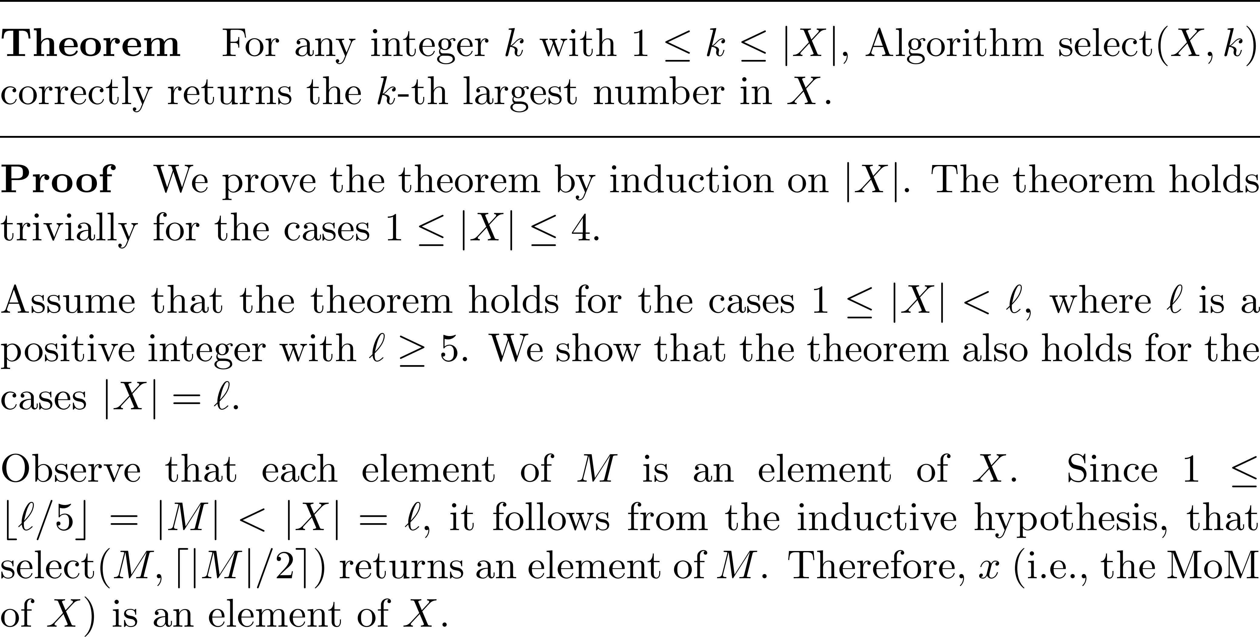
Correctness

Slide 21
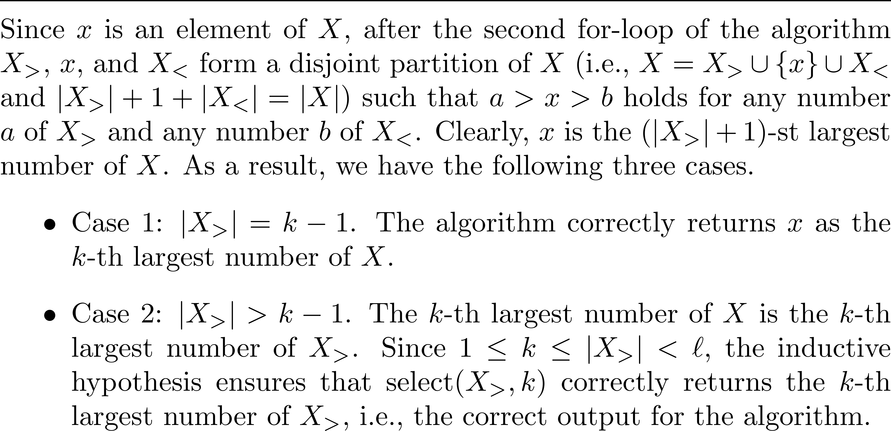
Correctness (cont.)

Slide 22
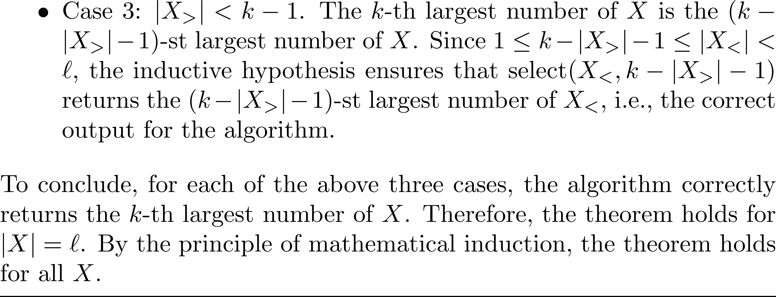
Correctness (cont.)

Slide 23
時間複雜度
O(1)
O(n)
O(n)
?

Slide 24
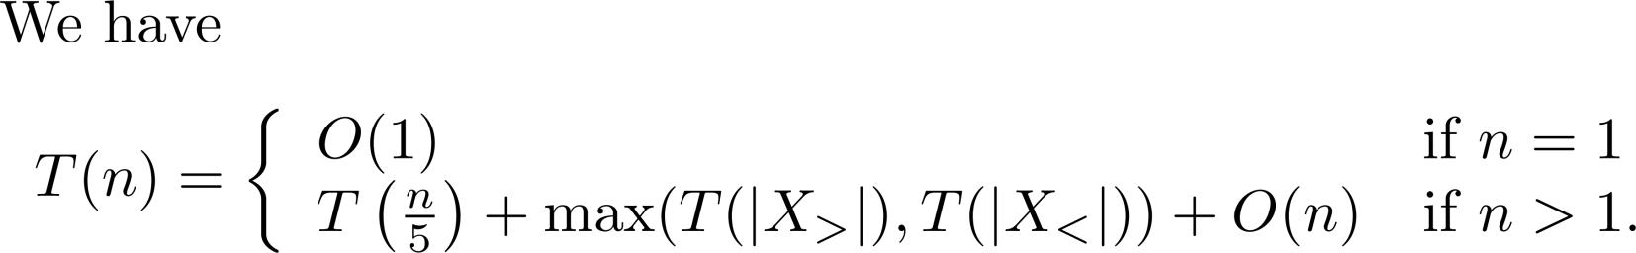
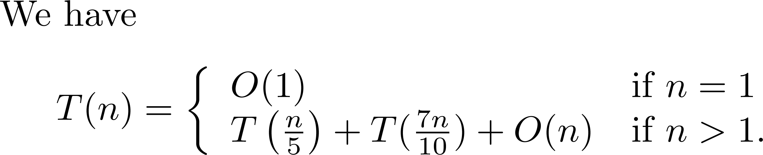
T(n): select(X, i) 的時間, |X| = n

Slide 25
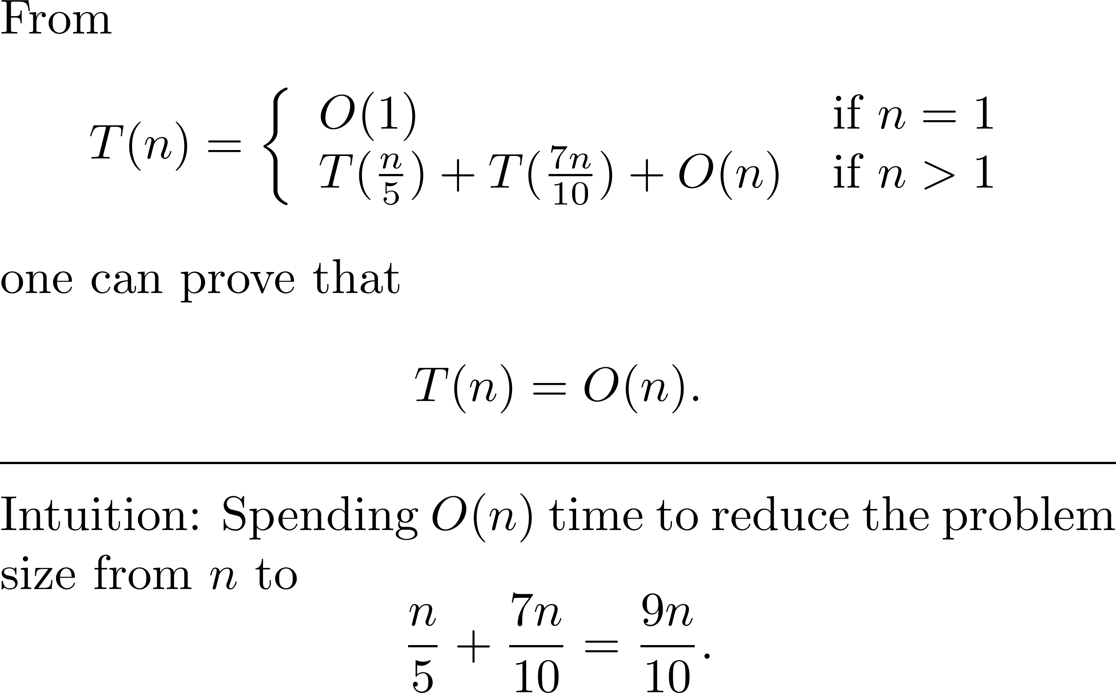
Recurrence relation

Slide 26
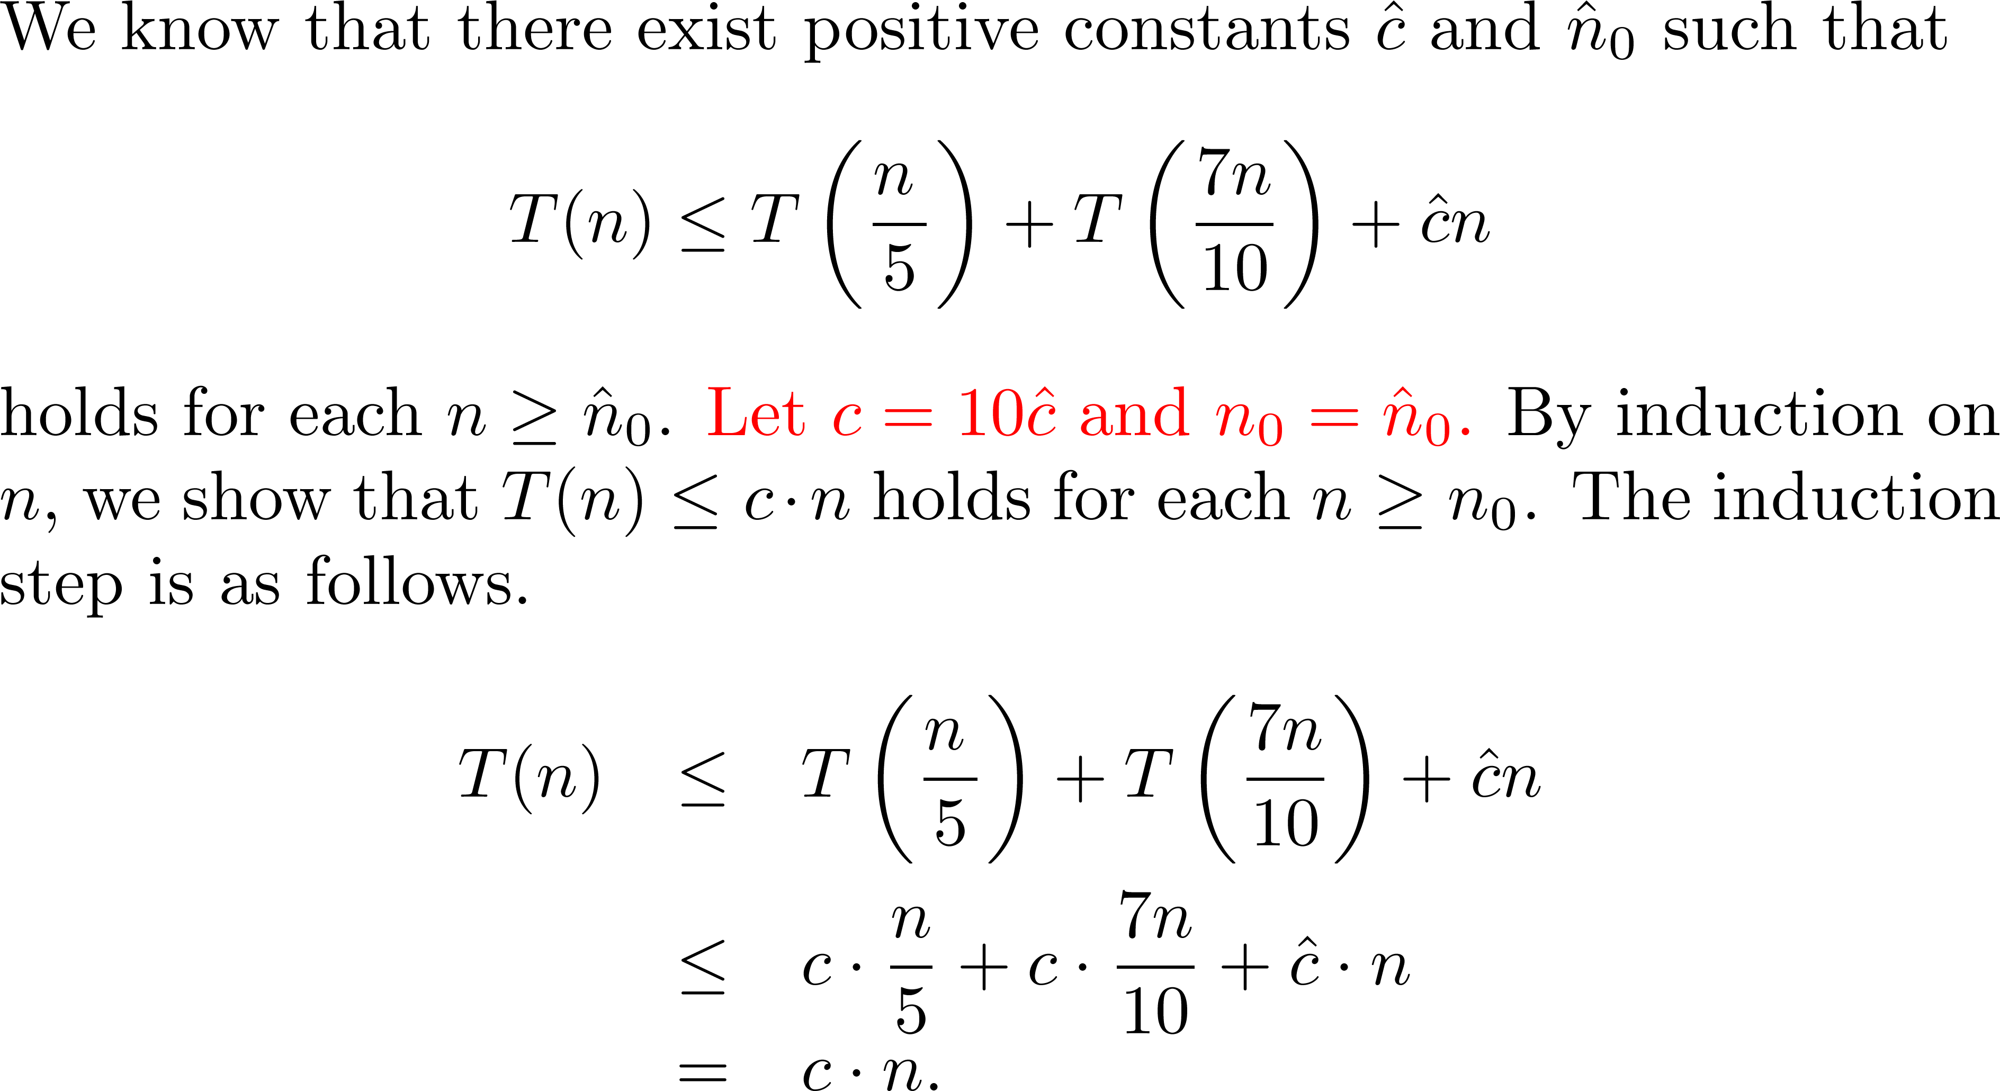
Proof sketch

Slide 27
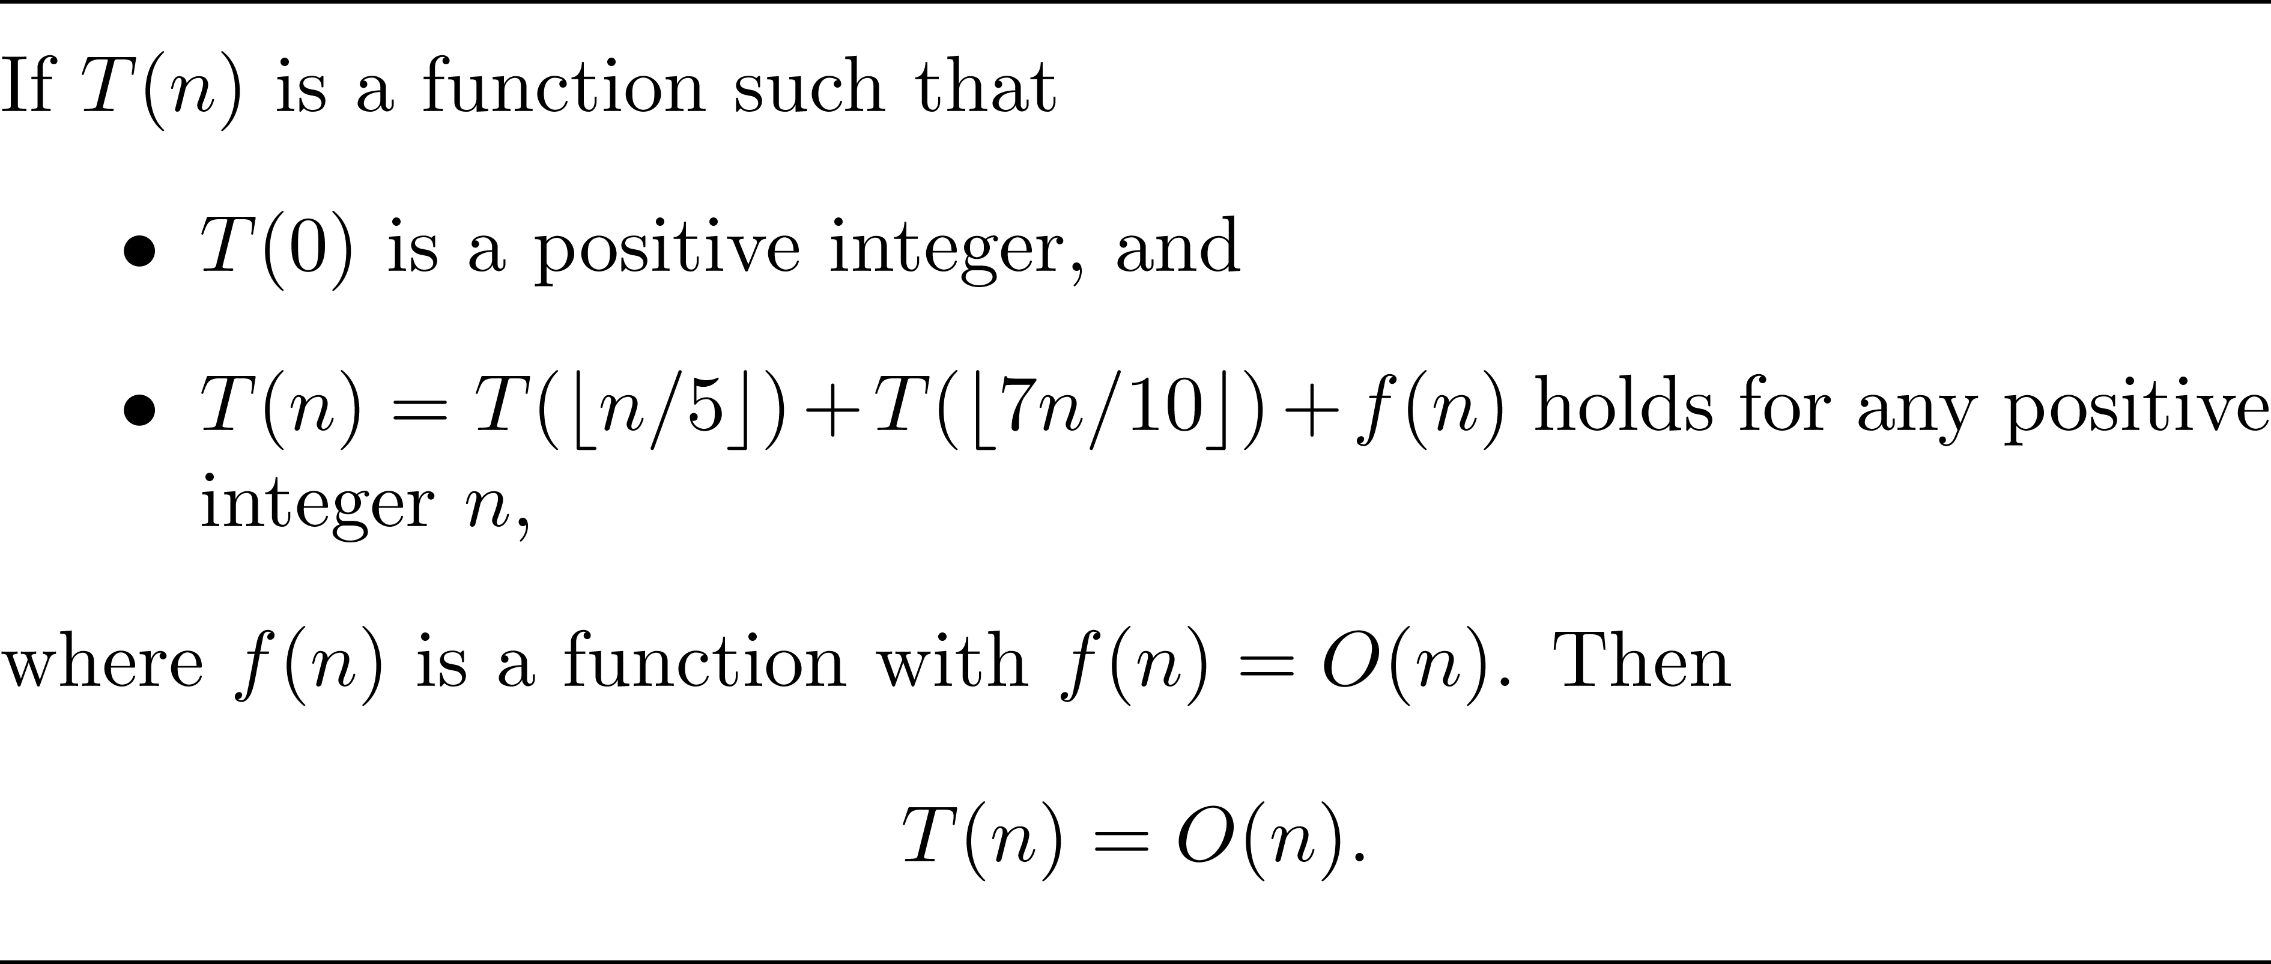
Theorem

Slide 28
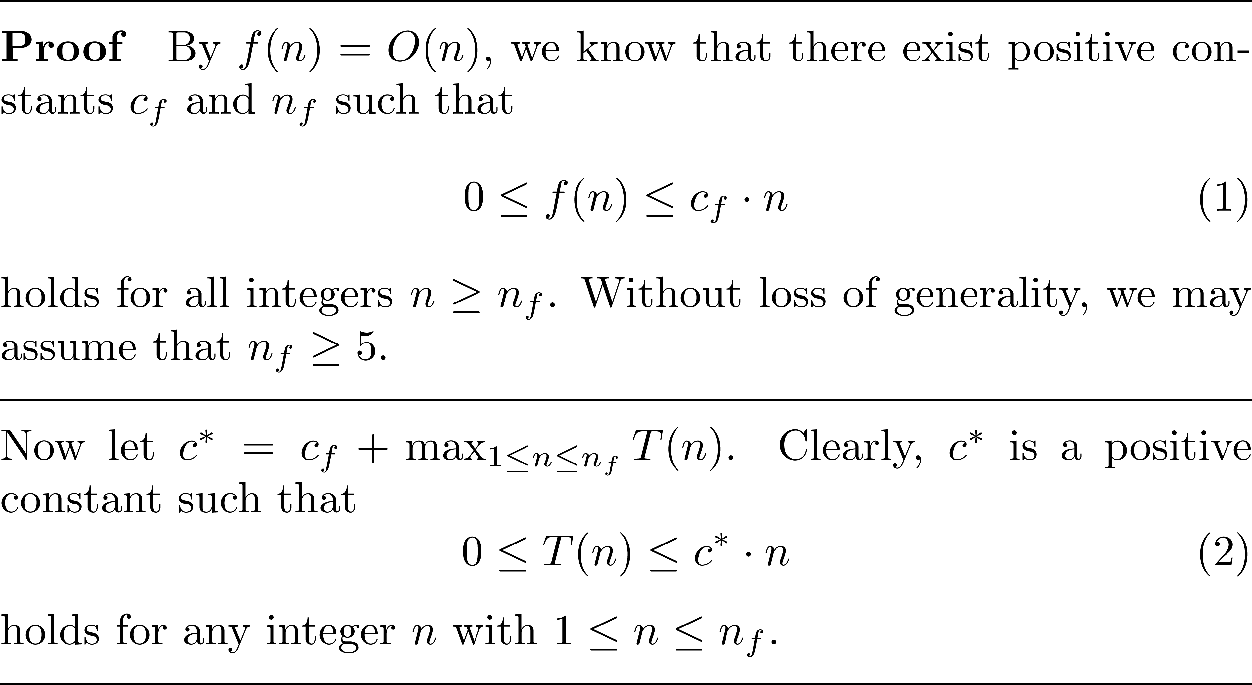
A proof

Slide 29
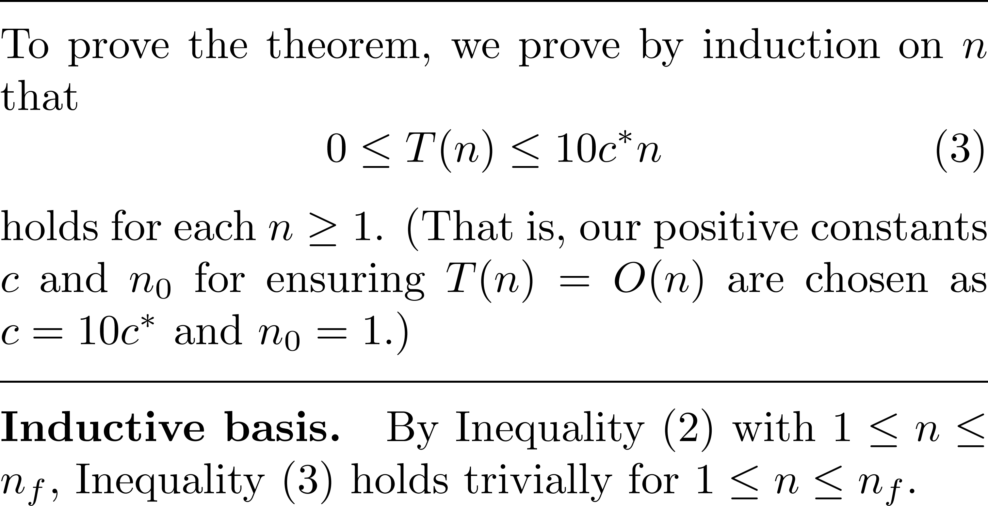
A proof (cont.)

Slide 30
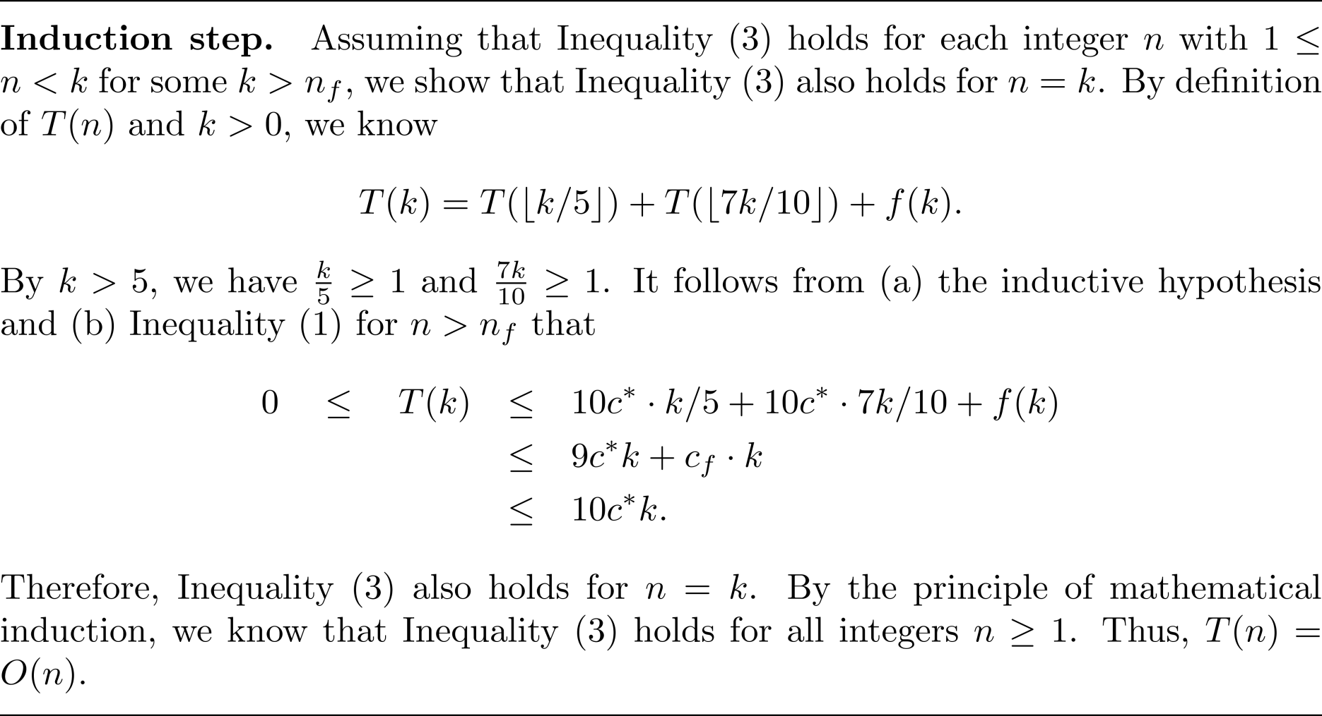
A proof (cont.)

Slide 31

只欠東風

Slide 32
看圖說故事

Slide 33
至少刪掉3n/10個傢伙

Slide 34

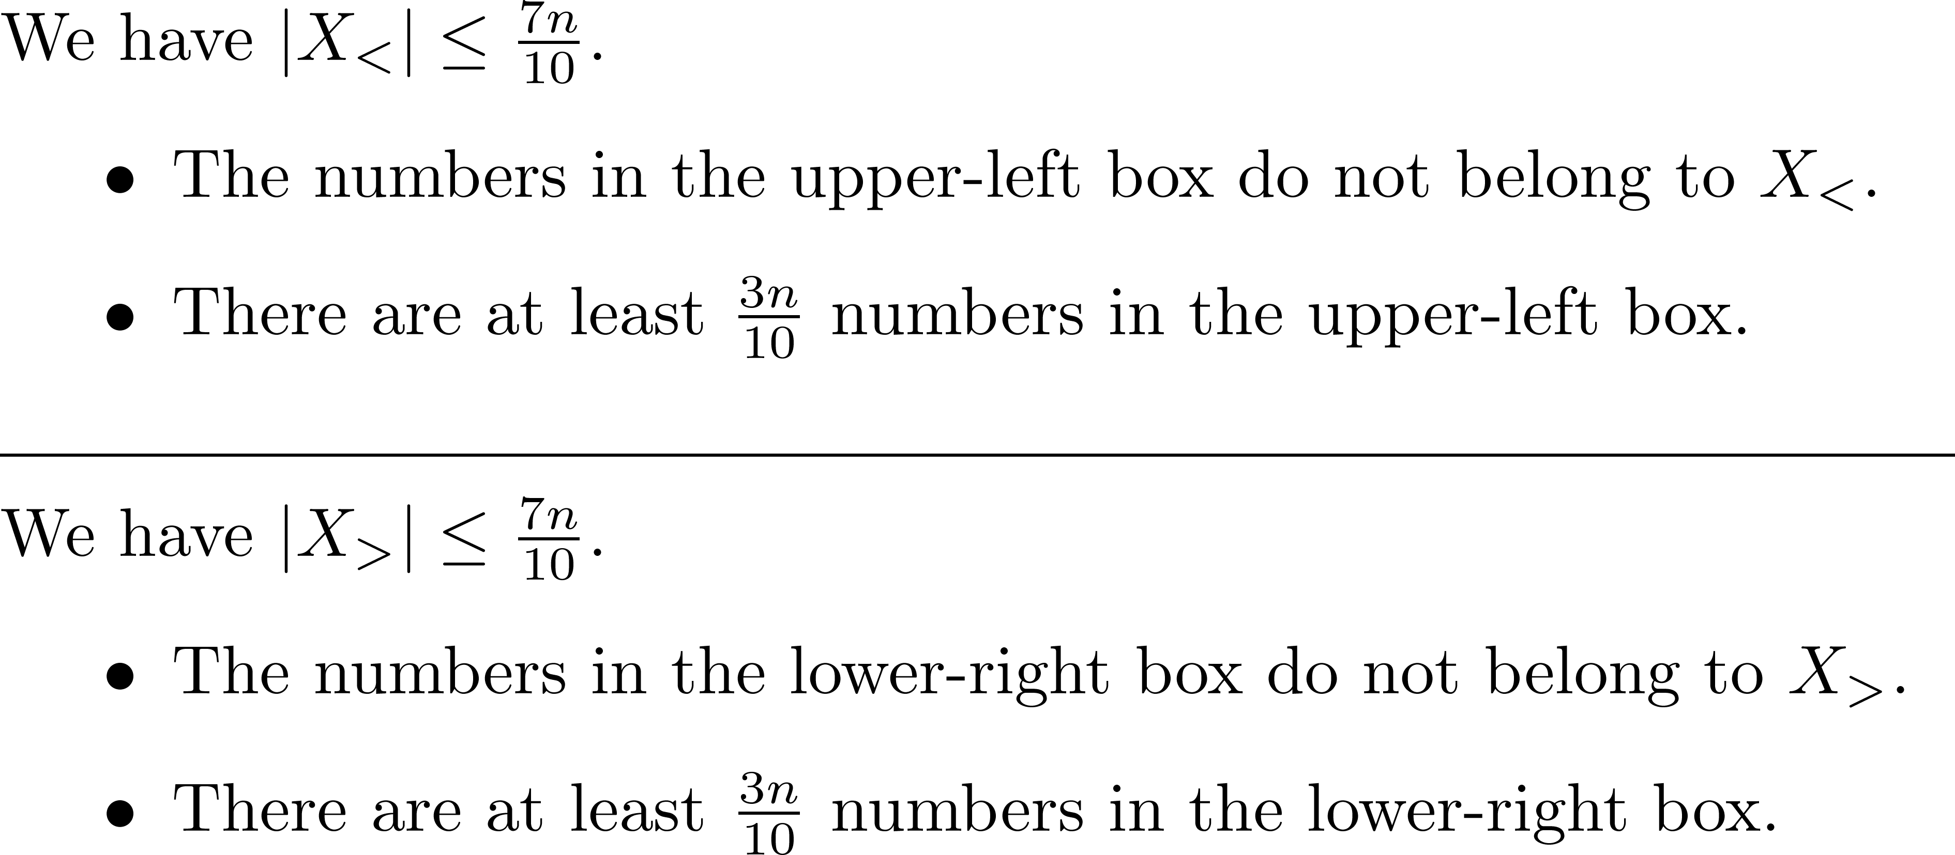
文字敘述

Slide 35
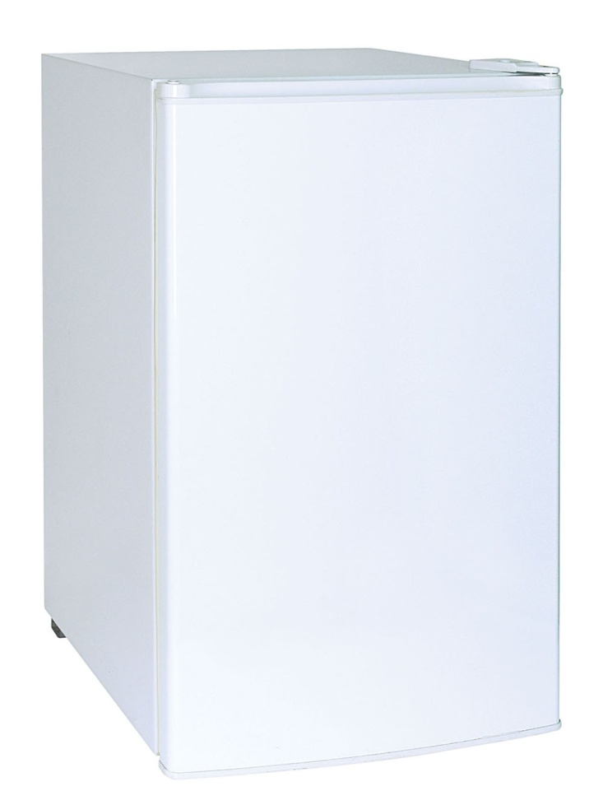
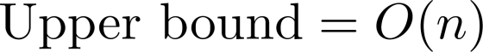
「挑選問題」的複雜度

